Slide 1
Mohammed Kamal mohammed Hassab Allah

Slide 2


Slide 3
Introduction web service
A Web service is a service offered by an electronic device to another electronic device, communicating with each other via the World Wide Web.
In a Web service, Web technology such as HTTP, originally designed for human-to-machine communication, is utilized for machine-to-machine communication, more specifically for transferring machine readable file formats such as XML and JSON.

Slide 4
Web service con…
In practice, the Web service typically provides an object-oriented Web-based interface to a database server, utilized for example by another Web server, or by a mobile application, that provides a user interface to the end user. Another common application offered to the end user may be a mash up, where a Web server consumes several Web services at different machines, and compiles the content into one user interface.

Slide 5
Web service con…
The W3C defines a Web service generally as:
a software system designed to support interoperable machine-to-machine interaction over a network.
In a 2002 document, the W3C Web Services Architecture Working Group defined a Web Services Architecture, requiring a standardized implementation of a "Web service." In this:

Slide 6
Web service con…
[a Web service] has an interface described in a machine-process able format (specifically WSDL). Other systems interact with the Web service in a manner prescribed by its description using SOAP (Simple Object Access Protocol) messages, typically conveyed using HTTP with an XML serialization in conjunction with other Web-related standards.

Slide 7
Web service con…
In a 2004 document, the W3C extended the definition:
We can identify two major classes of Web services:
REST-compliant Web services, in which the primary purpose of the service is to manipulate representations of Web resources using a uniform set of stateless operations.
Arbitrary Web services, in which the service may expose an arbitrary set of operations

Slide 8
Explanation what is WS
The term "Web service" describes a standardized way of integrating Web-based applications using the XML, SOAP, WSDL and UDDI open standards over an Internet protocol backbone. XML is the data format used to contain the data and provide metadata around it, SOAP is used to transfer the data, WSDL is used for describing the services available and UDDI lists what services are available.
A Web service is a method of communication between two electronic devices over a network. It is a software function provided at a network address over the Web with the service always on as in the concept of utility computing

Slide 9
Explanation what is WS
Different software may use different programming languages, and hence there is a need for a method of data exchange that doesn't depend upon a particular programming language. Most types of software can, however, interpret XML tags. Thus, Web services can use XML files for data exchange.
Rules for communication between different systems need to be defined, such as:
How one system can request data from another system.
Which specific parameters are needed in the data request
What would be the structure of the data produced. (Normally, data is exchanged in XML files, and the structure of the XML file is validated against an .xsd file.)
What error messages to display when a certain rule for communication is not observed, to make troubleshooting easier

Slide 10
Explanation what is WS
All of these rules for communication are defined in a file called WSDL (Web Services Description Language), which has a .wsdl extension. (Proposals for Autonomous Web Services (AWS) seek to develop more flexible Web services which do not rely on strict rules

Slide 11
Explanation what is WS
A directory called UDDI (Universal Description, Discovery and Integration) defines which software system should be contacted for which type of data. So when one software system needs one particular report/data, it would go to the UDDI and find out which other system it can contact for receiving that data. Once the software system finds out which other system it should contact, it would then contact that system using a special protocol called SOAP (Simple Object Access Protocol). The service provider system would first validate the data request by referring to the WSDL file, and then process the request and send the data under the SOAP protocol

Slide 12
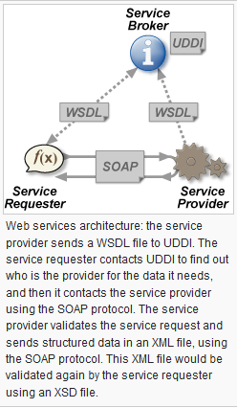
SOAP,WSDL,UDDI and XML

Slide 13
Benefit of web service
Different software systems often need to exchange data with each other, and a Web service is a method of communication that allows two software systems to exchange this data over the internet. The software system that requests data is called a service requester, whereas the software system that would process the request and provide the data is called a service provider.

Slide 14
Benefit of web service
II. Different software may use different programming languages, and hence there is a need for a method of data exchange that doesn't depend upon a particular programming language. Most types of software can, however, interpret XML tags. Thus, Web services can use XML files for data exchange

Slide 15
What is Soap
SOAP (Simple Object Access Protocol) is a protocol specification for exchanging structured information in the implementation of web services in computer networks. Its purpose is to induce extensibility, neutrality and independence. It uses XML Information Set for its message format, and relies on application layer protocols, most often Hypertext Transfer Protocol (HTTP) or Simple Mail Transfer Protocol (SMTP), for message negotiation and transmission.

Slide 16
SOAP con..
SOAP provides the Messaging Protocol layer of a web services protocol stack for web services. It is XML-based protocol consisting of three parts:
an envelope, which defines the message structure and how to process it
a set of encoding rules for expressing instances of application-defined data types
a convention for representing procedure calls and responses

Slide 17
SOAP has three major characteristics
extensibility (security and WS-routing are among the extensions under development)
neutrality (SOAP can operate over any protocol such as HTTP, SMTP, TCP, UDP, or JMS)
independence (SOAP allows for any programming model)

Slide 18
The SOAP architecture consists of several layers of specifications for
message format
Message Exchange Patterns (MEP)
underlying transport protocol bindings
message processing models
protocol extensibility

Slide 19
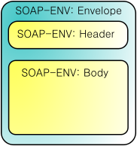
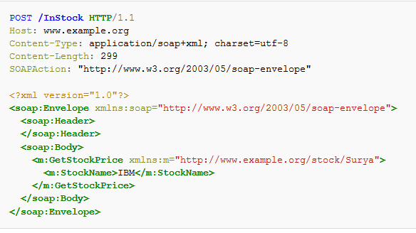
example

Slide 20
Protocol Concepts
SOAP: The set of rules formalizing and governing the format and processing rules for information exchanged between a SOAP sender and a SOAP receiver.
SOAP Nodes: These are physical/logical machines with processing units which are used to transmit/forward, receive and process SOAP messages. These are analogous to Node (networking).
SOAP Roles: Over the path of a SOAP message, all nodes assume a specific role. The role of the node defines the action that the node performs on the message it receives. For example, a role "none" means that no node will process the SOAP header in any way and simply transmit the message along its path.
SOAP protocol binding : A SOAP message needs to work in conjunction with other protocols to be transferred over a network. For example, a SOAP message could use TCP as a lower layer protocol to transfer messages. These bindings are defined in the SOAP protocol binding framework.
SOAP features: SOAP provides a messaging framework only. However, it can be extended to add features such as reliability, security etc. There are rules to be followed when adding features to the SOAP framework.
SOAP module : A collection of specifications regarding the semantics of SOAP header to describe any new features being extended upon SOAP. A module needs to realize 0 or more features. SOAP requires modules to adhere to prescribed rules

Slide 21
Data Encapsulation Concepts
SOAP message: Represents the information being exchanged between 2 soap nodes.
SOAP envelope : As per its name, it is the enclosing element of an XML message identifying it as a SOAP message.
SOAP header block: A SOAP header can contain more than one of these blocks, each being a discrete computational block within the header. In general, the SOAP role information is used to target nodes on the path. A header block is said to be targeted at a SOAP node if the SOAP role for the header block is the name of a role in which the SOAP node operates. (ex: A SOAP header block with role attribute as ultimate Receiver is targeted only at the destination node which has this role. A role attribute as next is targets each intermediary as well as the destination node.)
SOAP header : A collection of one or more header blocks targeted at each SOAP receiver.
SOAP body : Contains the body of the message intended for the SOAP receiver. The interpretation and processing of SOAP body is defined by header blocks.
SOAP fault: In case a SOAP node fails to process a SOAP message, it adds the fault information to the SOAP fault element. This element is contained within the SOAP body as a child element.

Slide 22
Message Sender and Receiver Concepts
SOAP sender: The node that transmits a SOAP message.
SOAP receiver : The node receiving a SOAP message. (Could be an intermediary or the destination node)
SOAP message path : The path consisting of all the nodes that the SOAP message traversed to reach the destination node.
Initial SOAP sender: This is the node which originated the SOAP message to be transmitted. This is the root of the SOAP message path.
SOAP intermediary: All the nodes in between the SOAP originator and the intended SOAP destination. It processes the SOAP header blocks targeted at it and acts to forward a SOAP message towards an ultimate SOAP receiver.
Ultimate SOAP receiver: The destination receiver of the SOAP message. This node is responsible for processing the message body and any header blocks targeted at it

Slide 23
Let us make SOAP application step by step

Slide 24
First step
Create database called Amani and has table called register
On table contain password and name

Slide 25
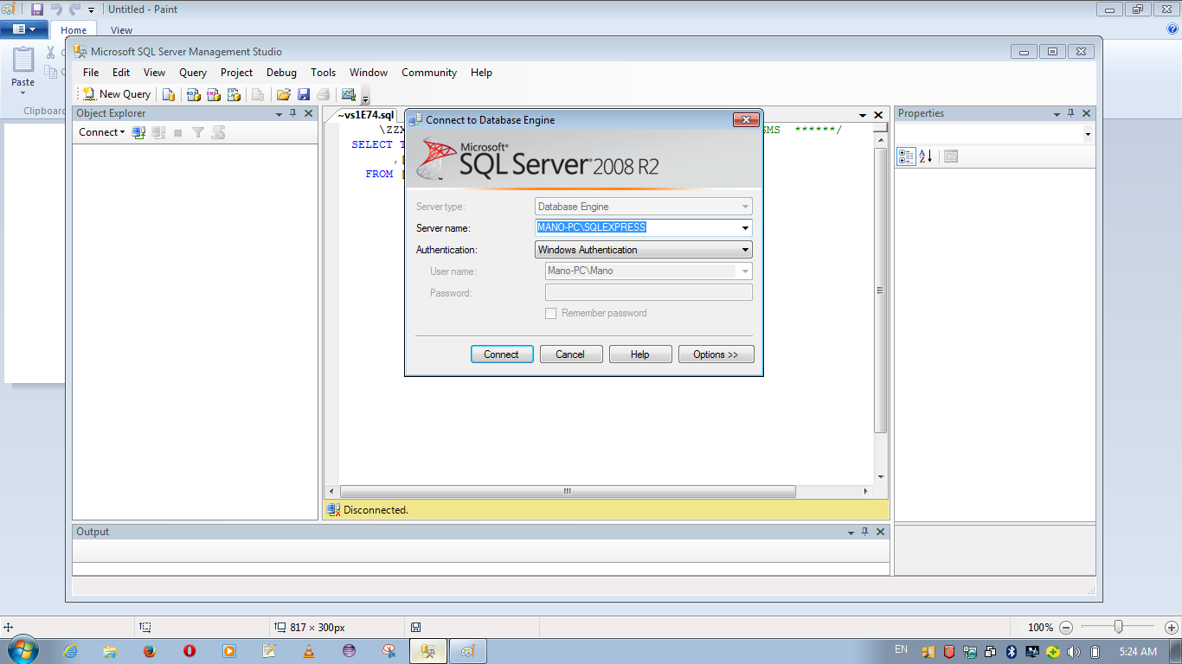

Slide 26
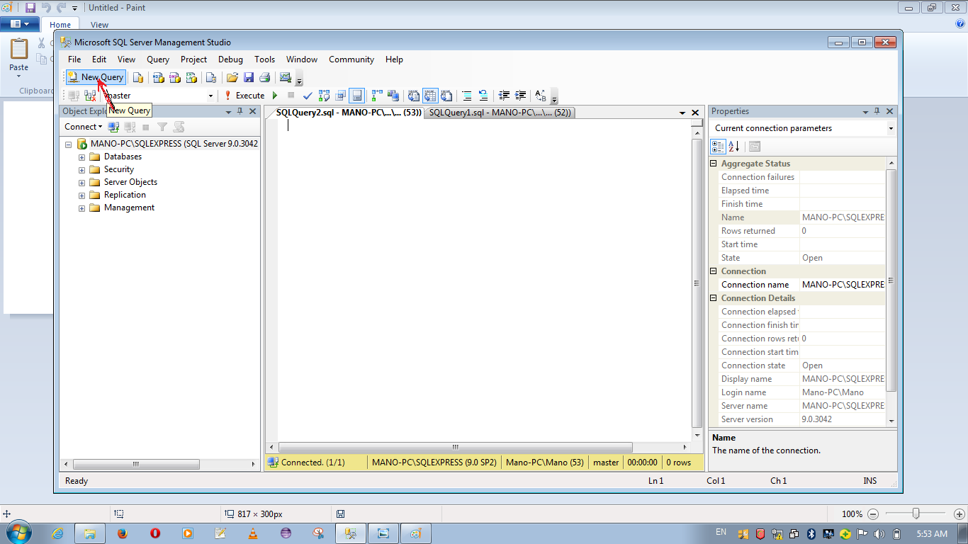

Slide 27
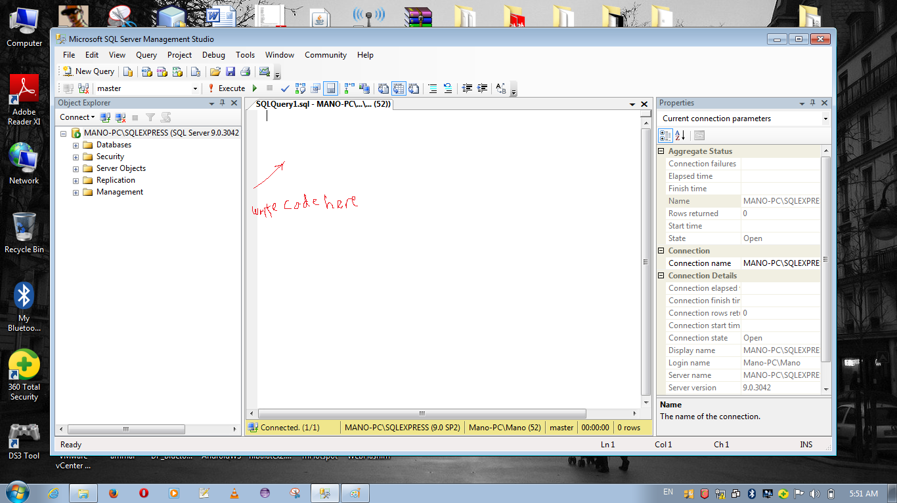

Slide 28
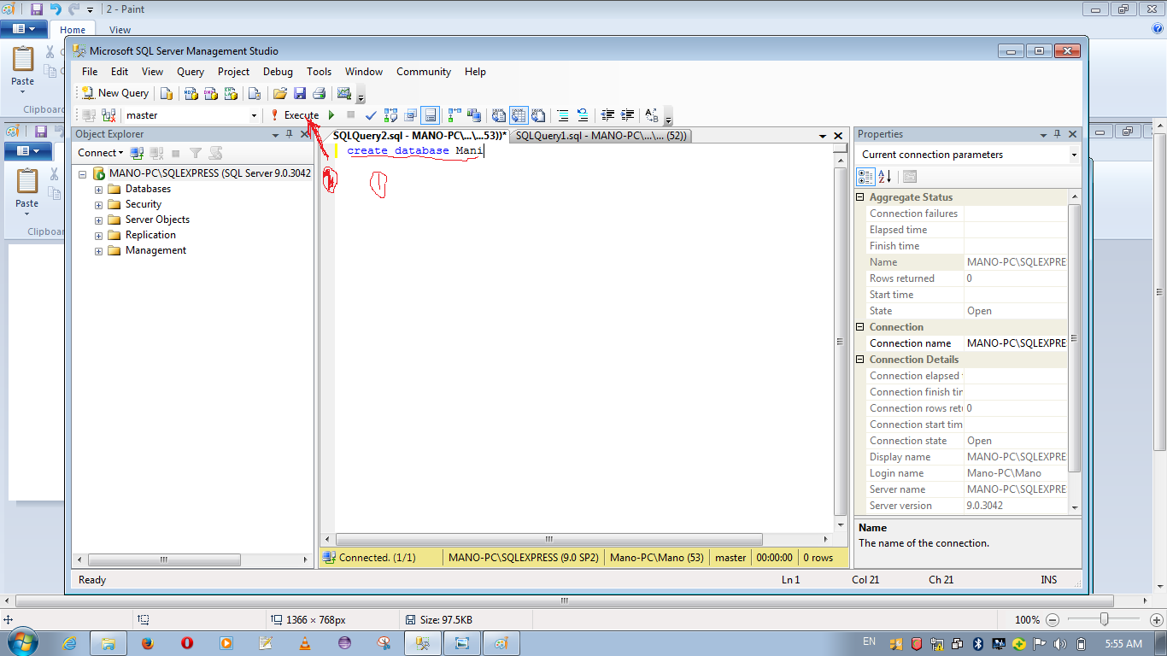

Slide 29
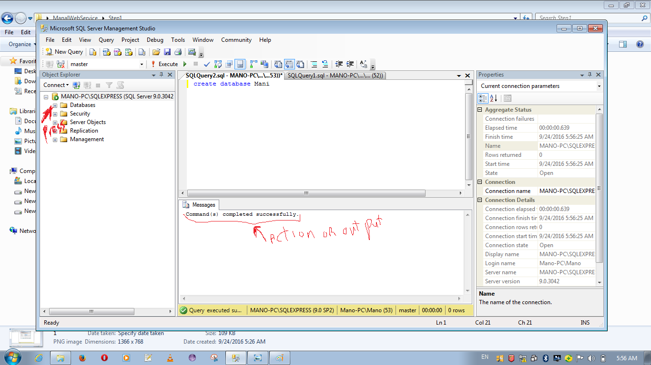

Slide 30
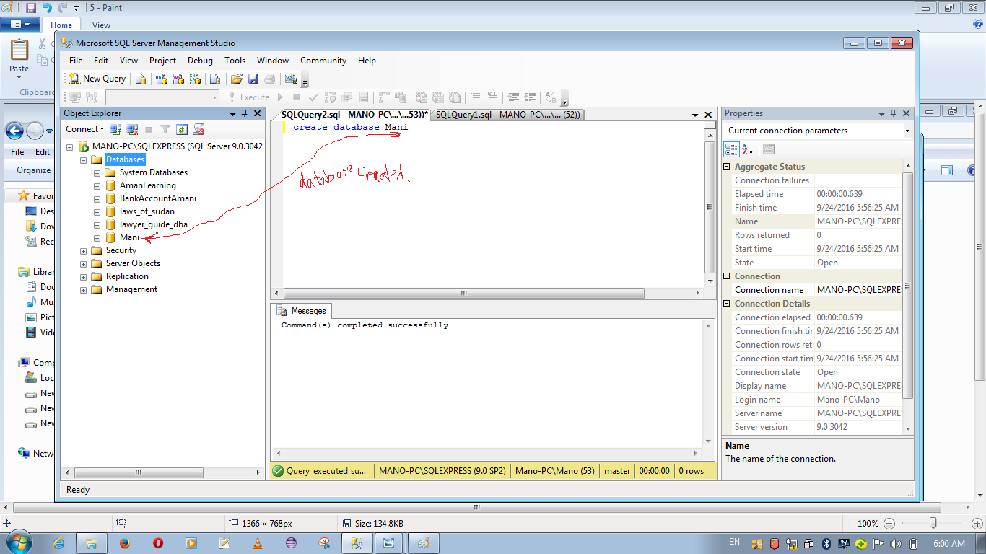

Slide 31
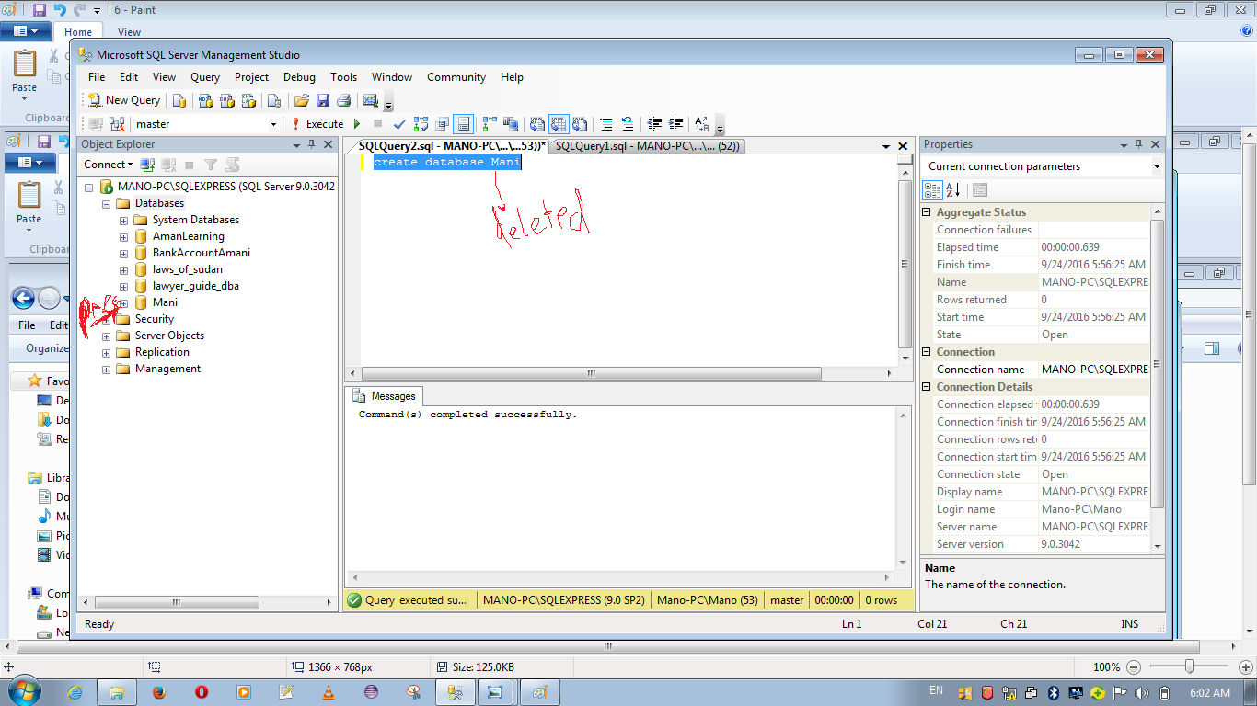

Slide 32
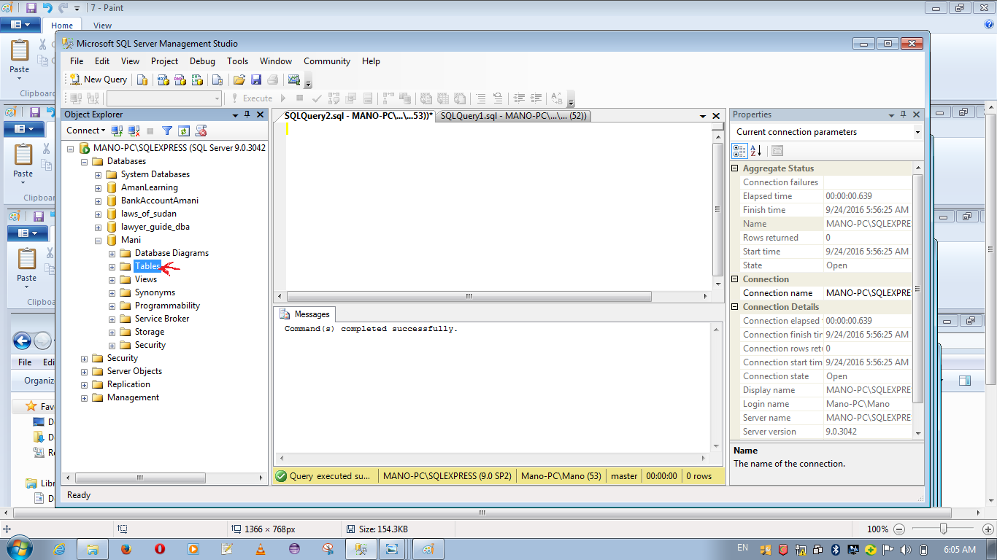

Slide 33
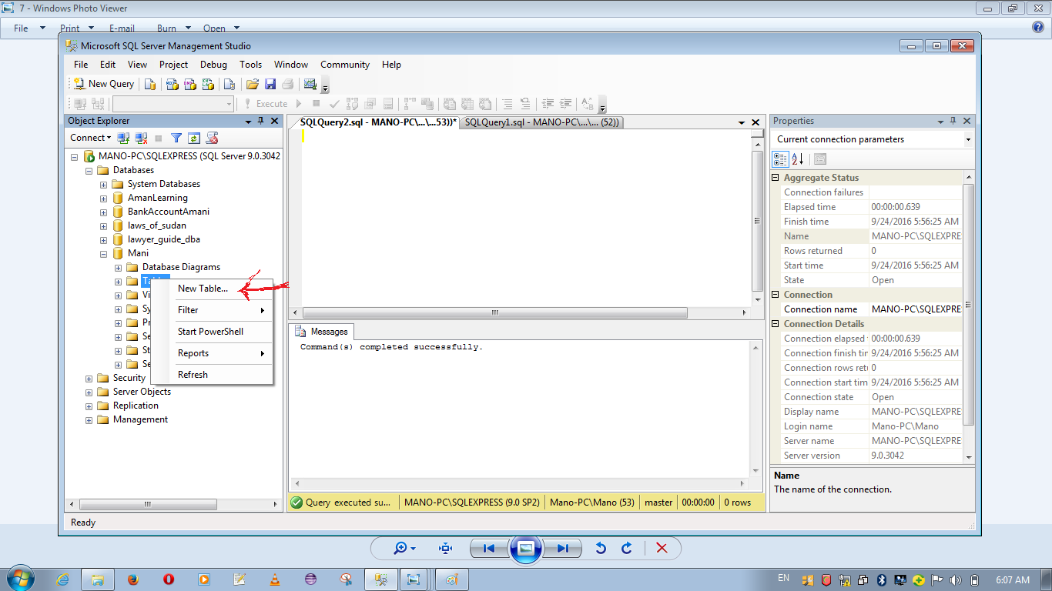

Slide 34
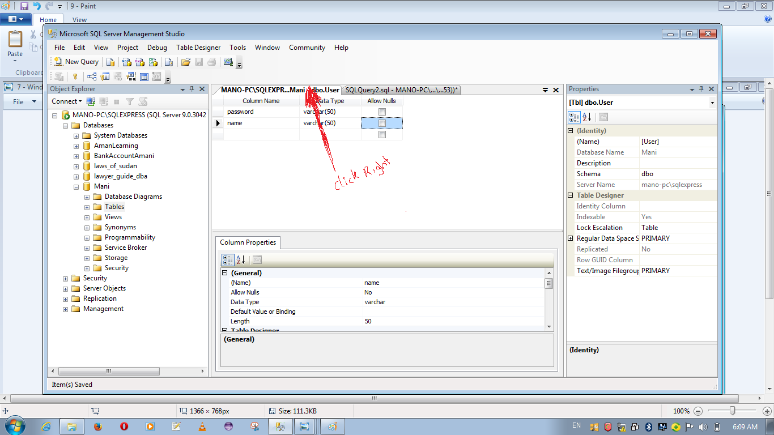

Slide 35
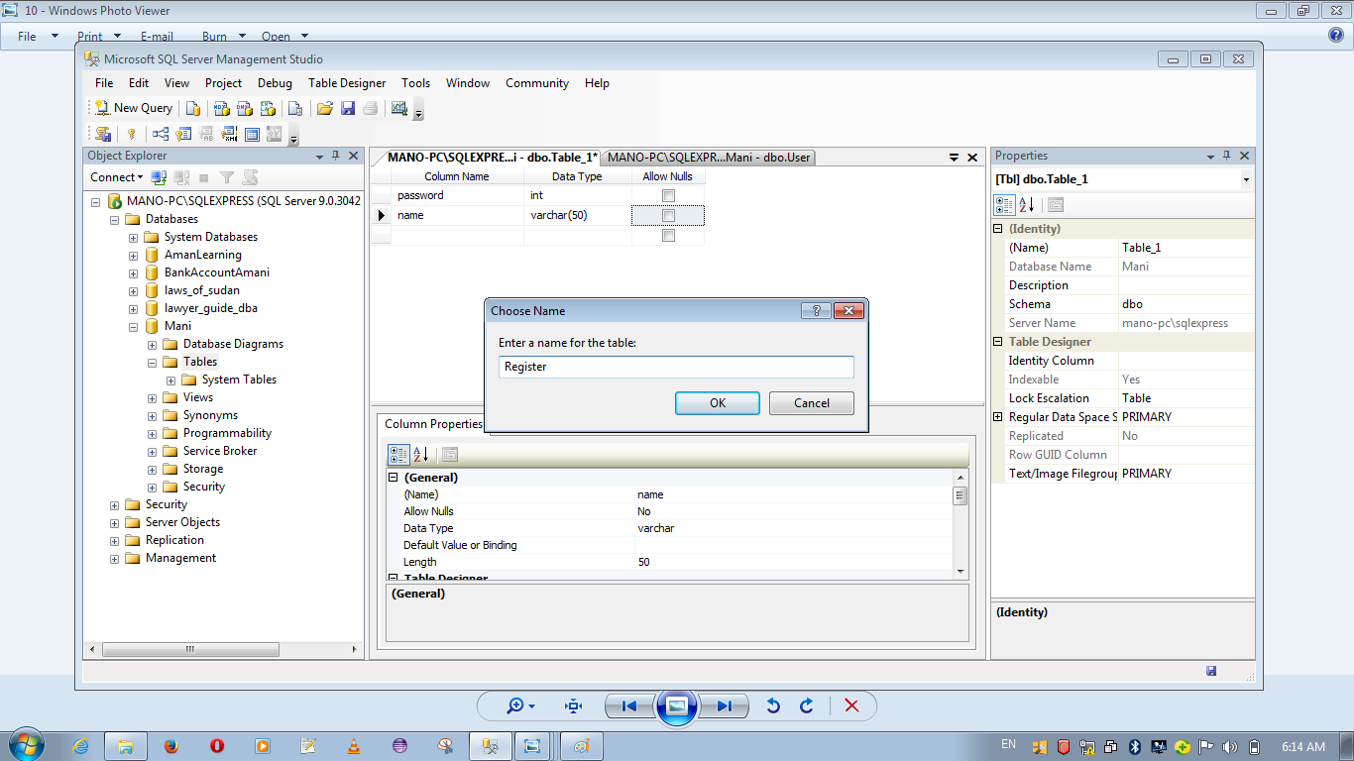

Slide 36
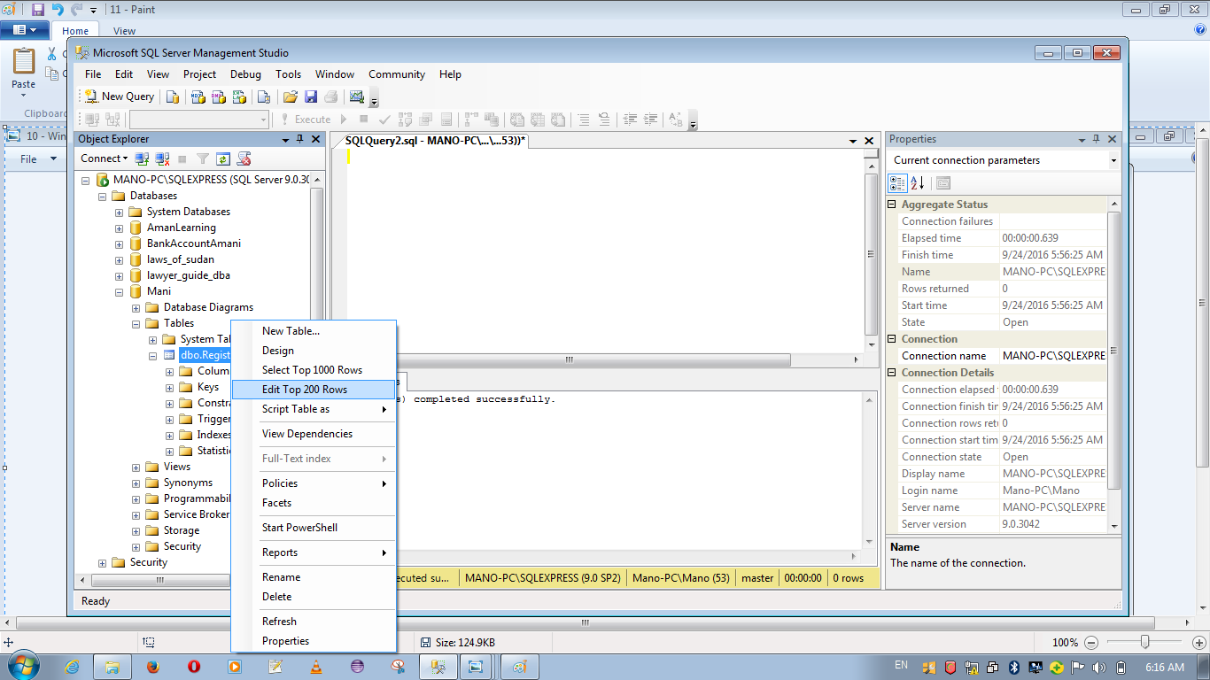

Slide 37
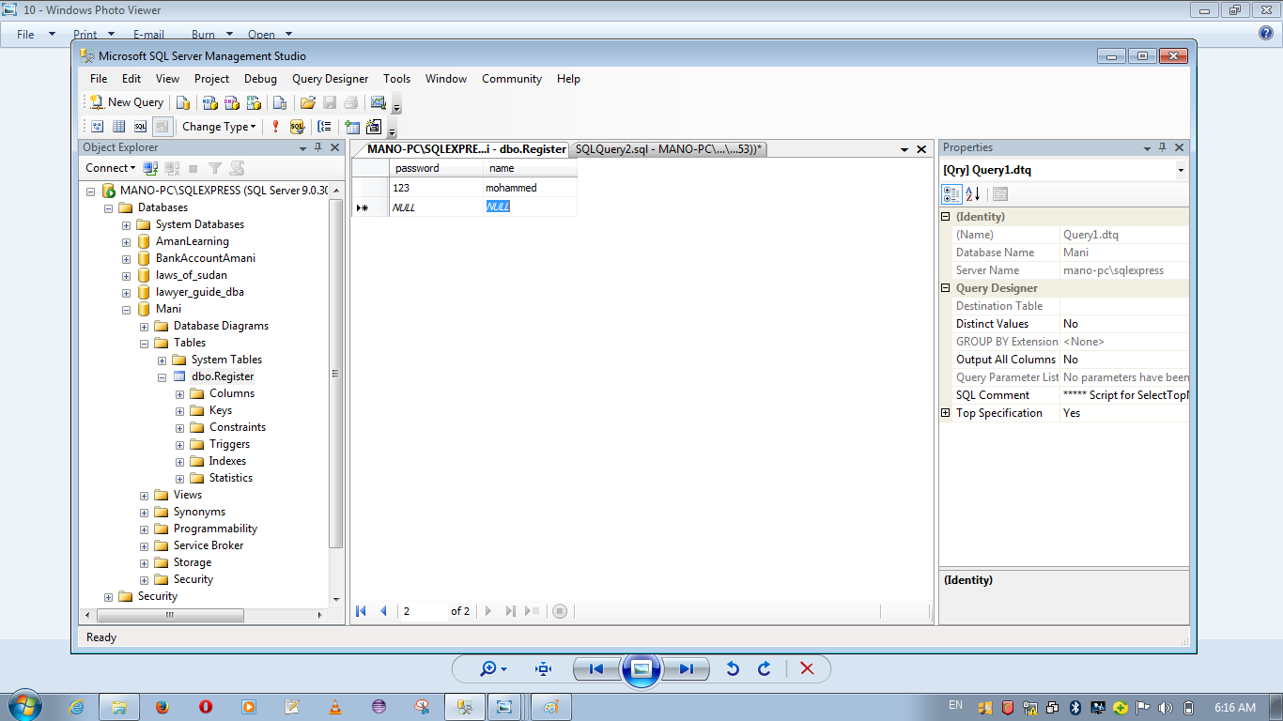

Slide 38
Second step
Creating web service ,has web method called register _web with tow parameter password and name .after this method work well and successful interact with database then web service well be responsible to take request from the client after that well send as query to data base then web service take response on database and send it to client as response .

Slide 39
Con….
after make sure web work very well we need to publish the project as executable file in any other device .

Slide 40
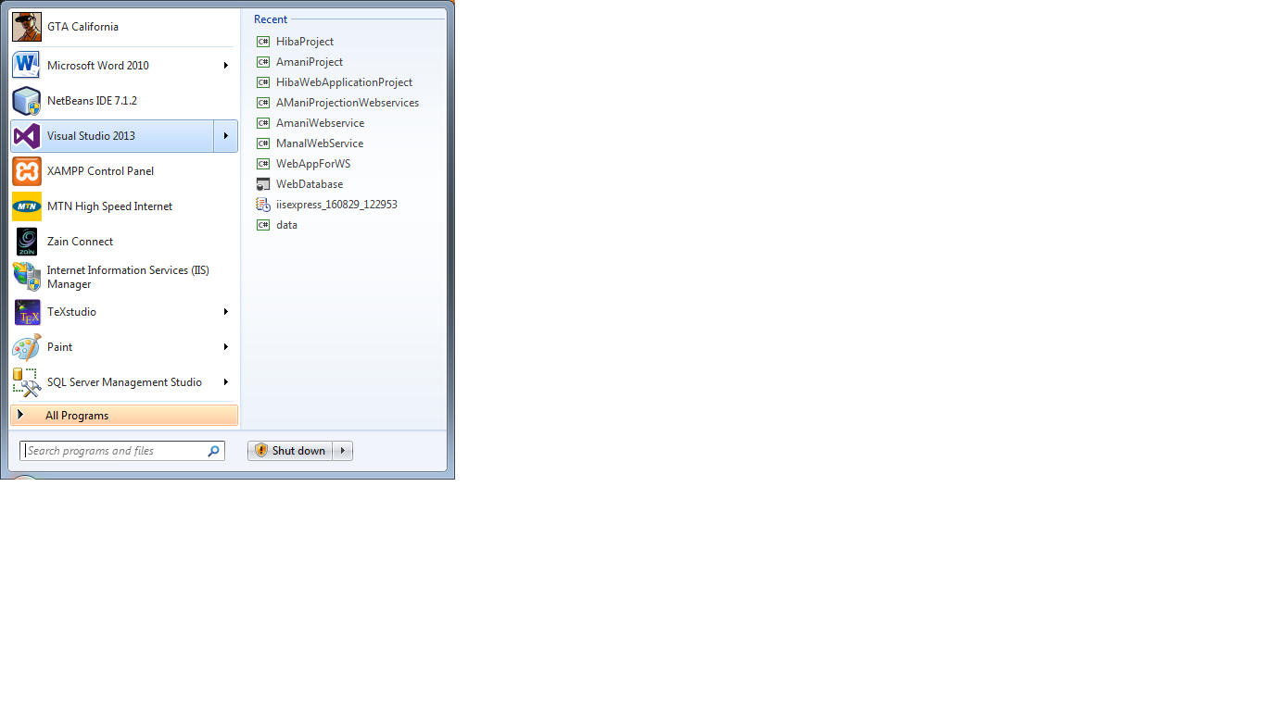

Slide 41
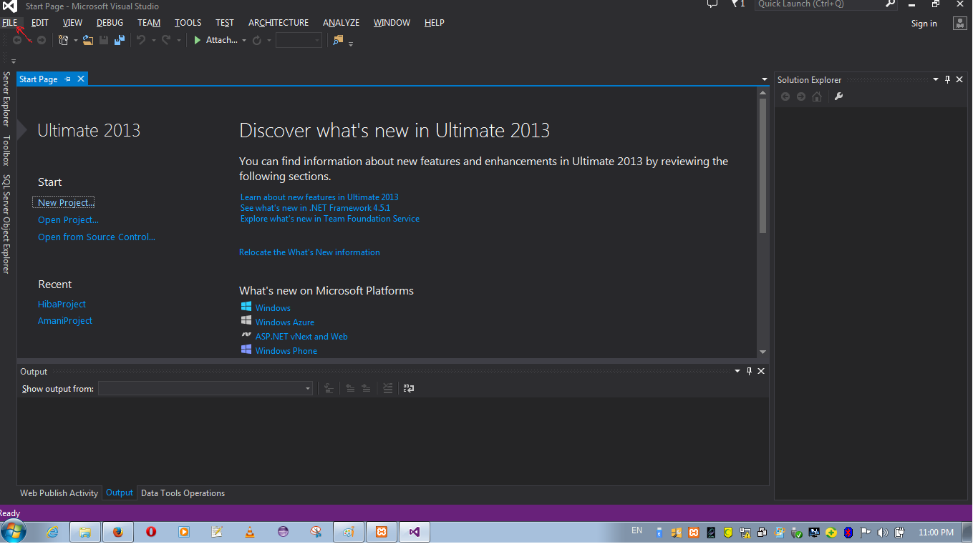

Slide 42
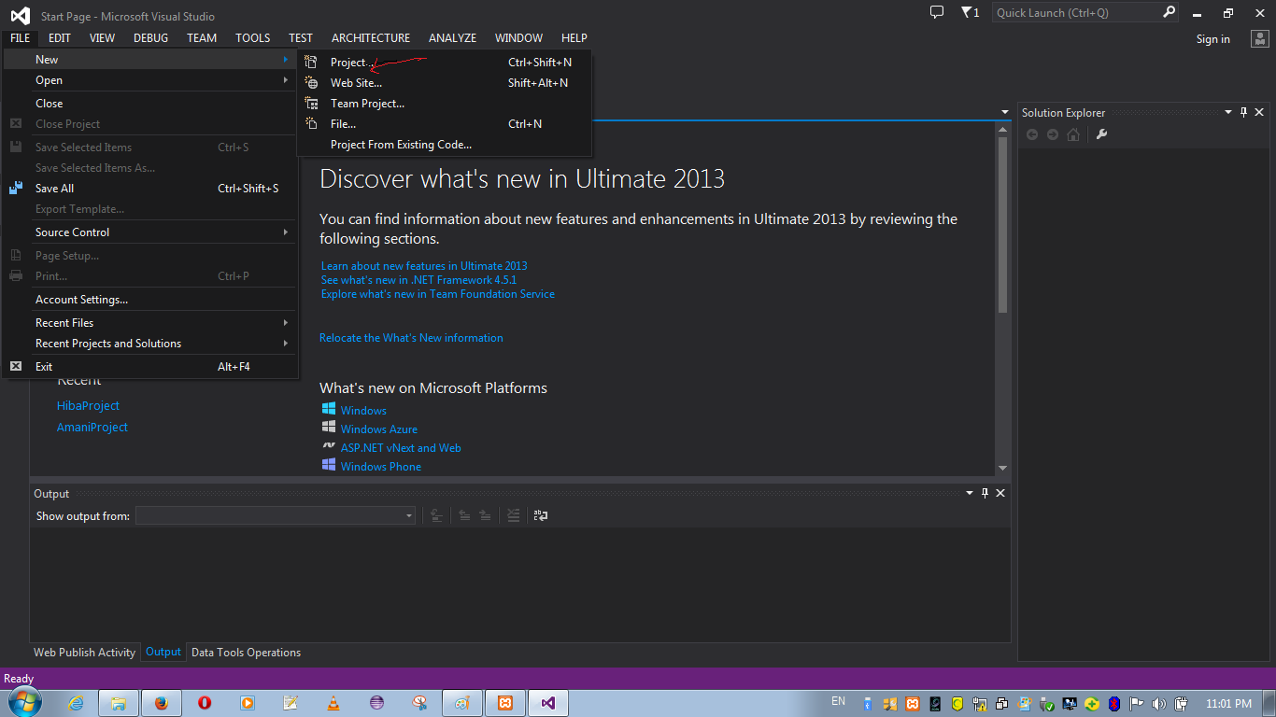

Slide 43
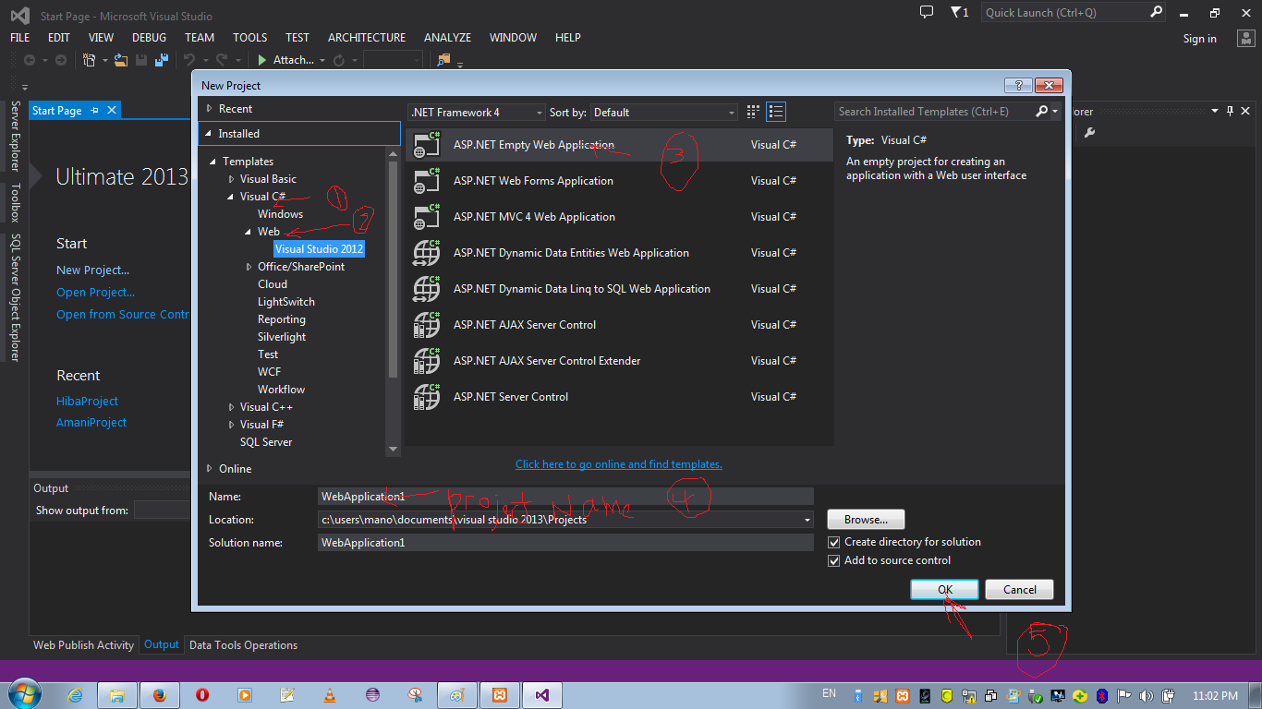

Slide 44
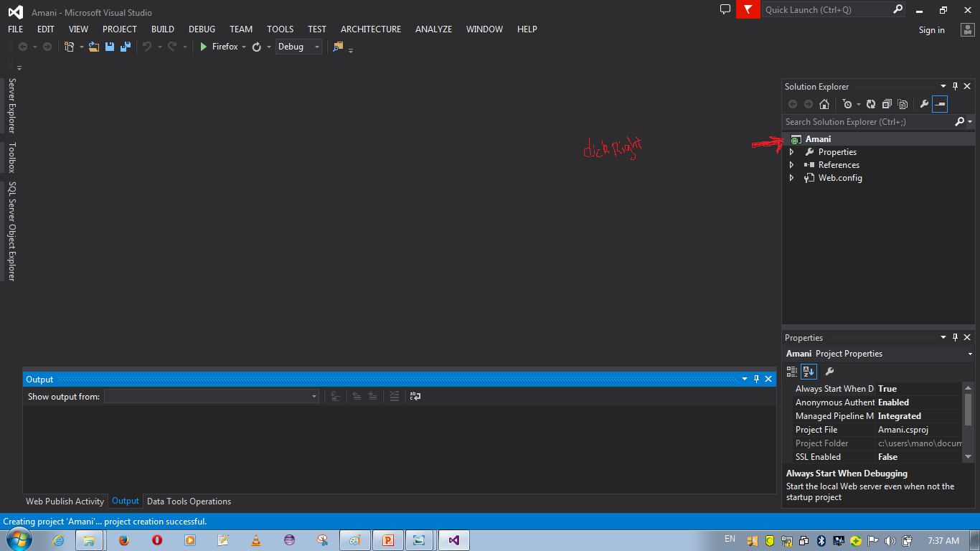

Slide 45
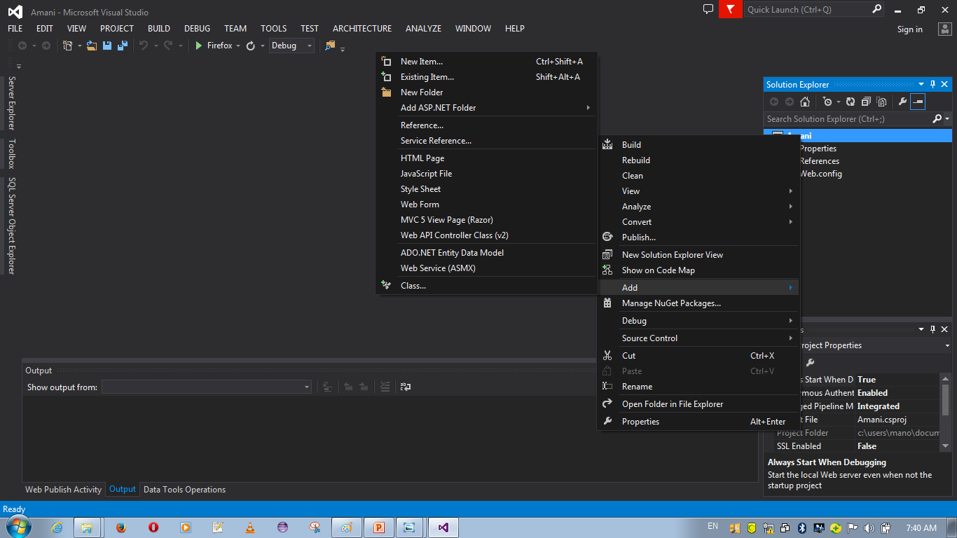

Slide 46
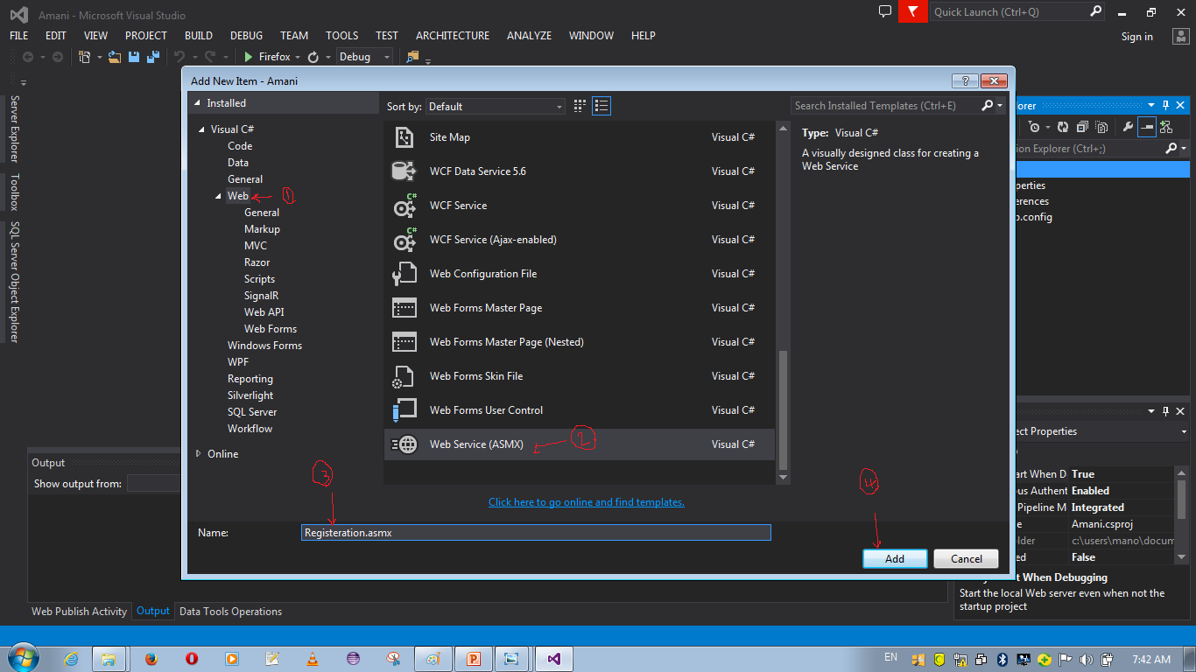

Slide 47
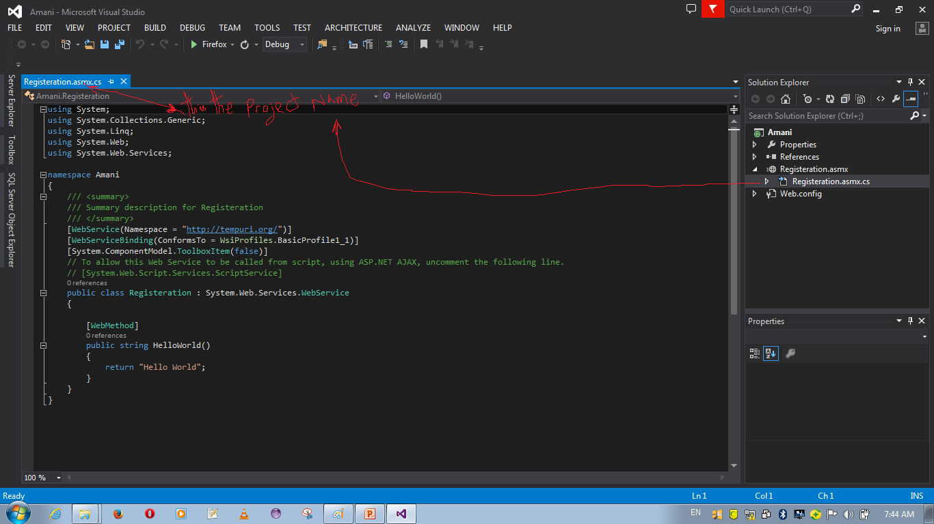

Slide 50
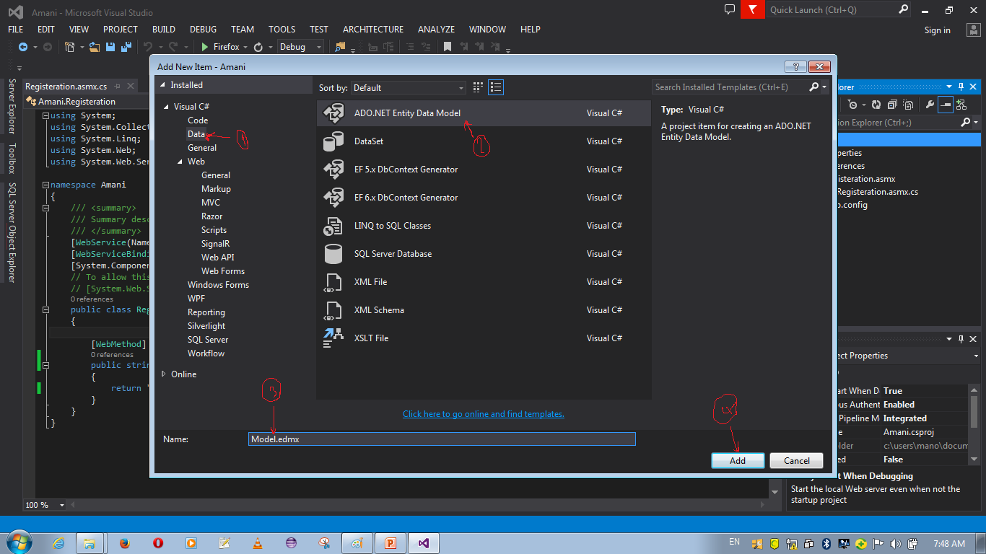

Slide 51
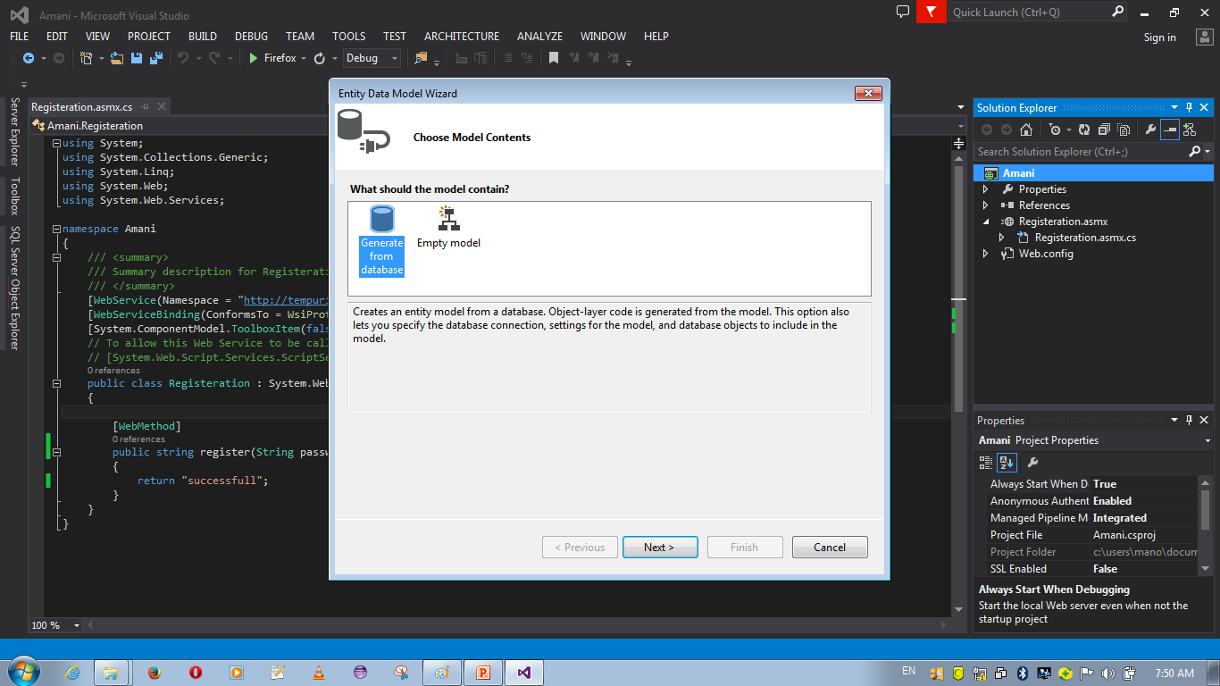

Slide 52
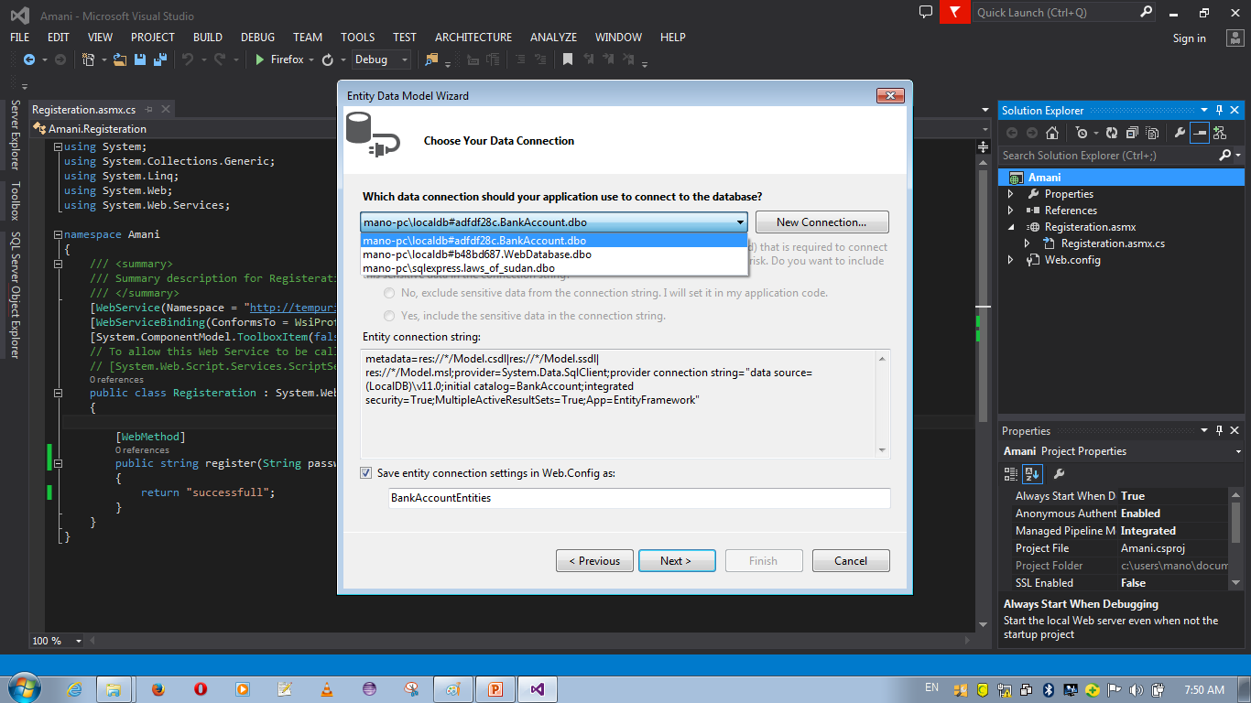

Slide 53
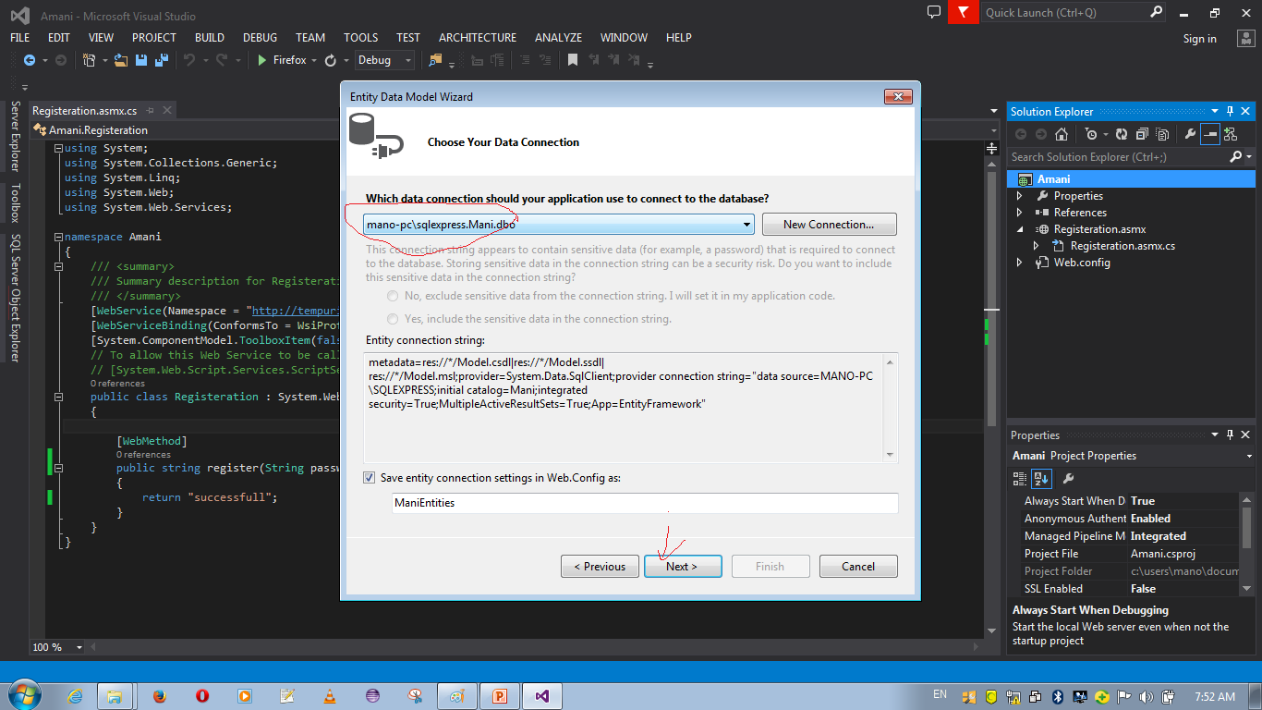

Slide 54
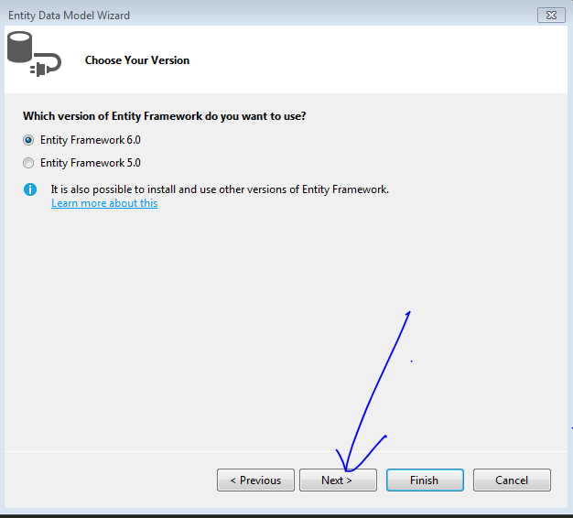

Slide 55
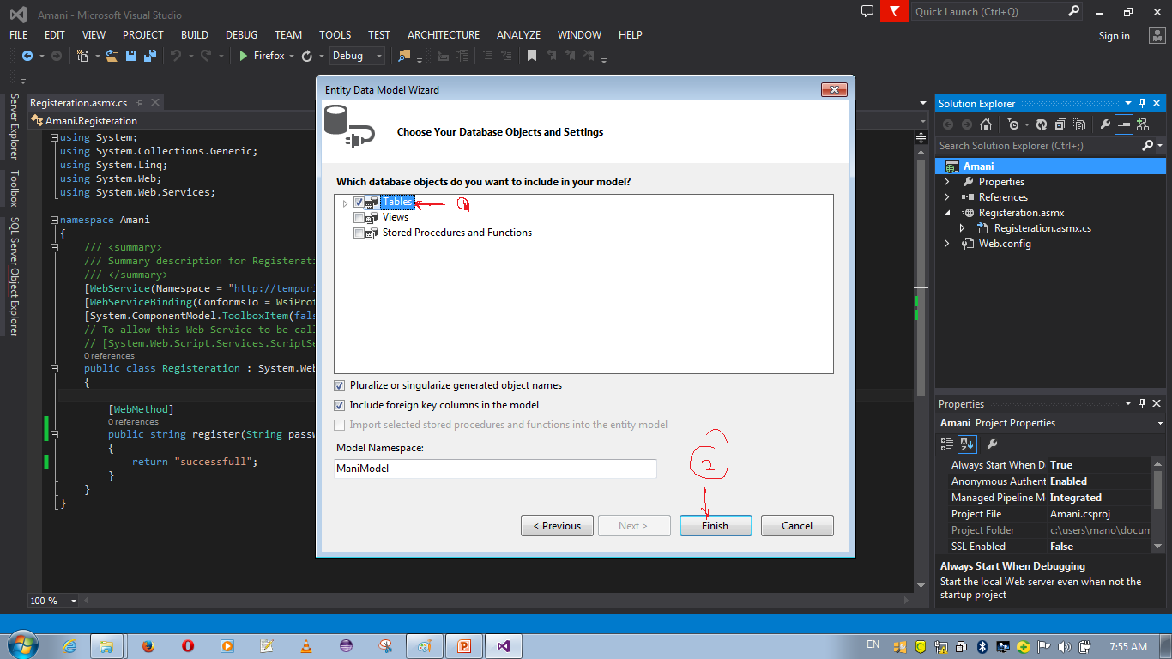

Slide 56
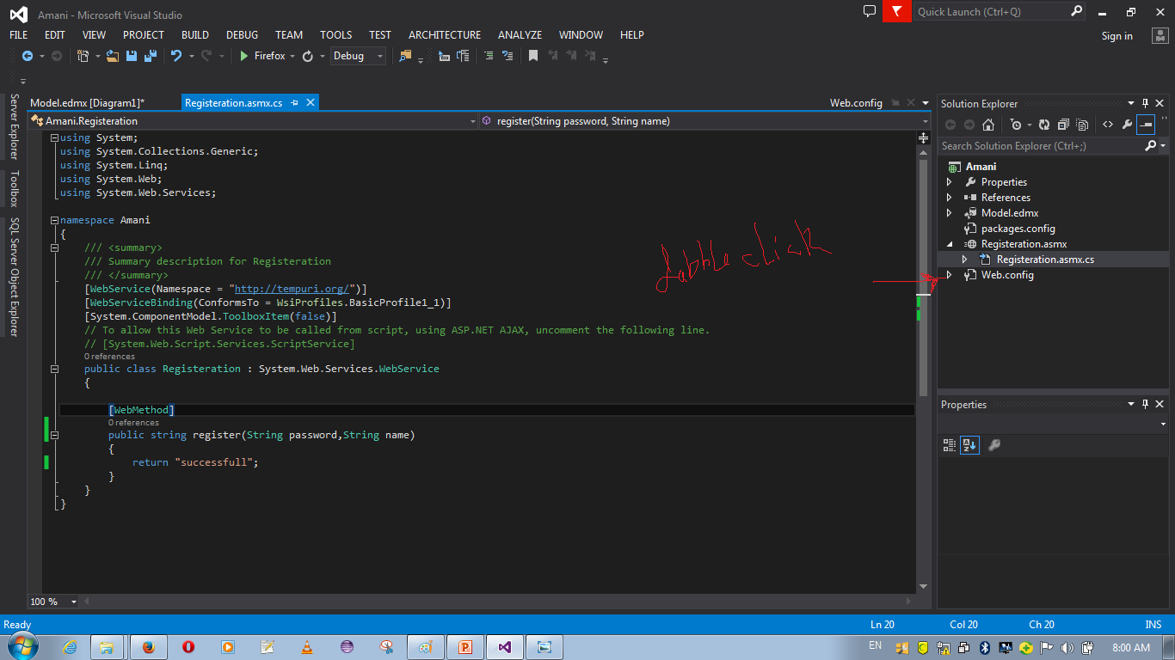

Slide 57
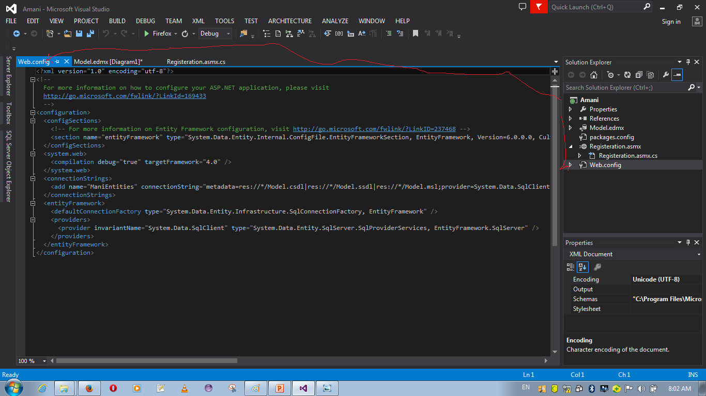

Slide 58
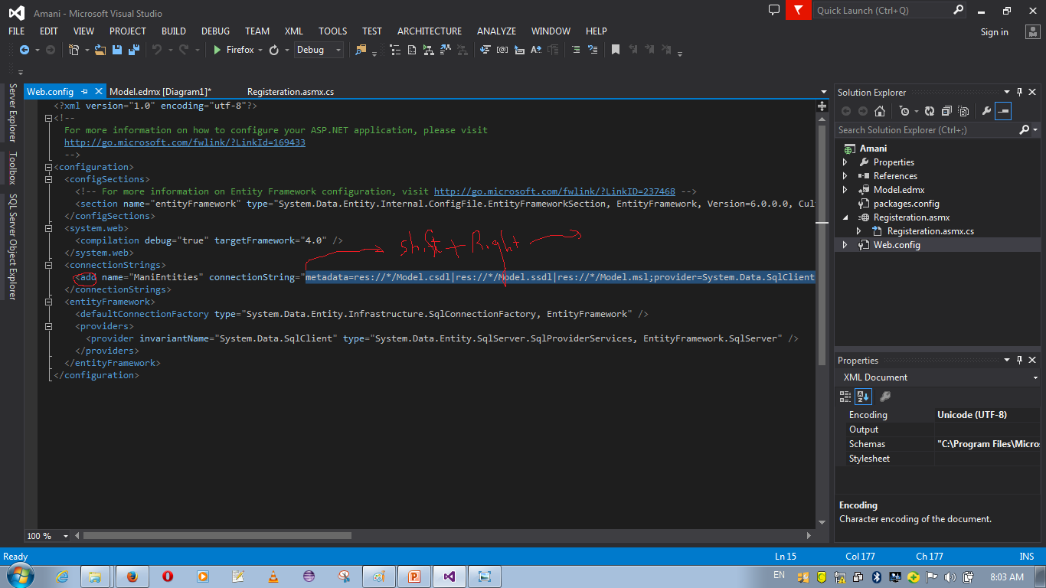

Slide 59
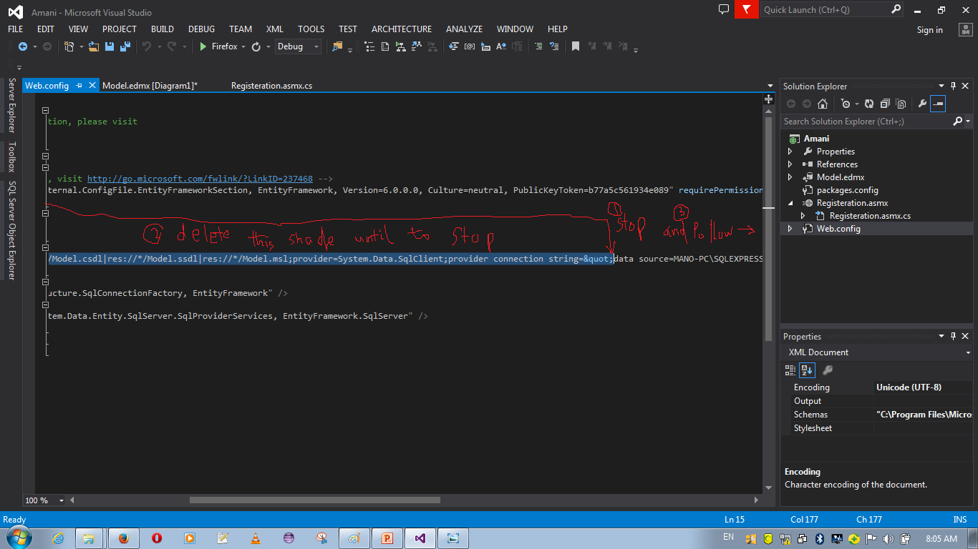

Slide 60
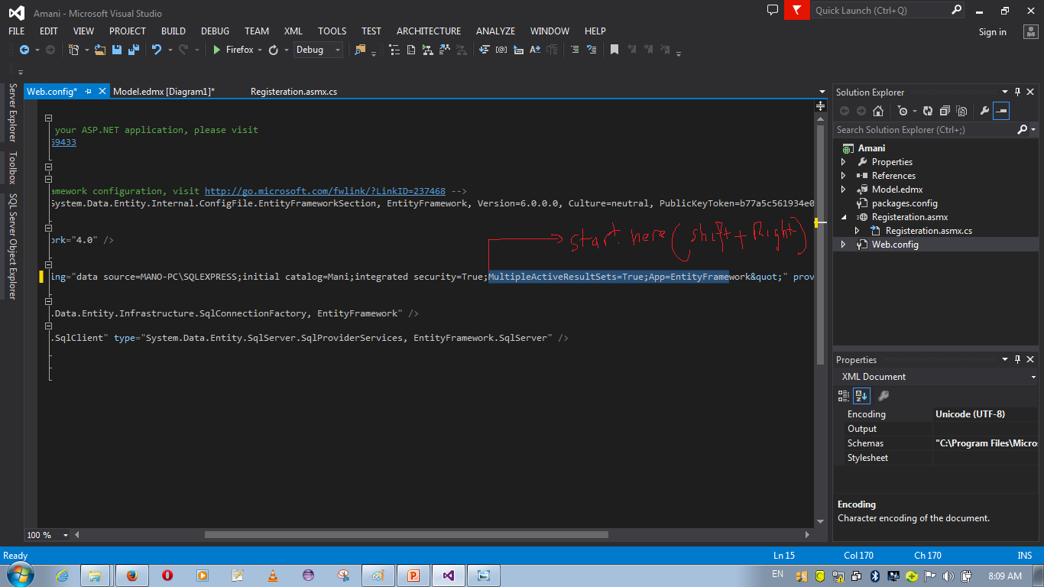

Slide 61
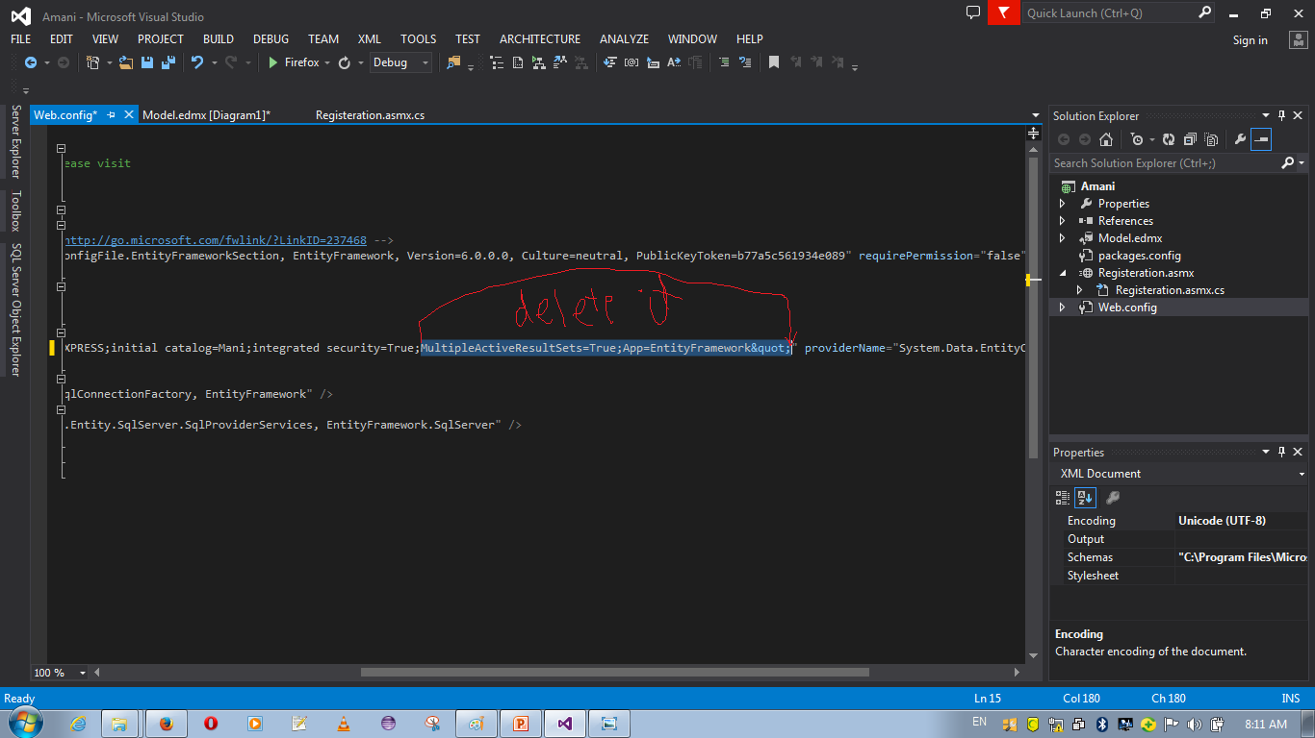

Slide 62
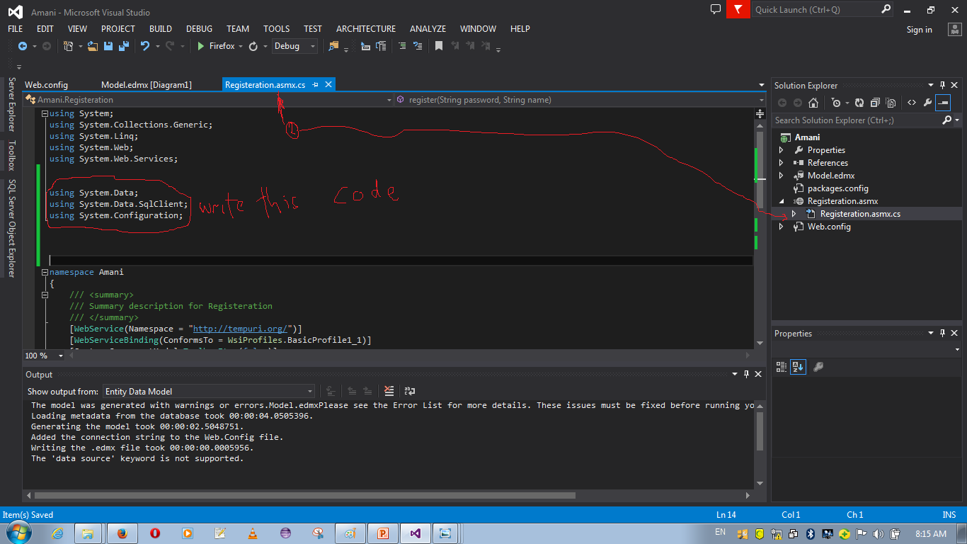

Slide 63
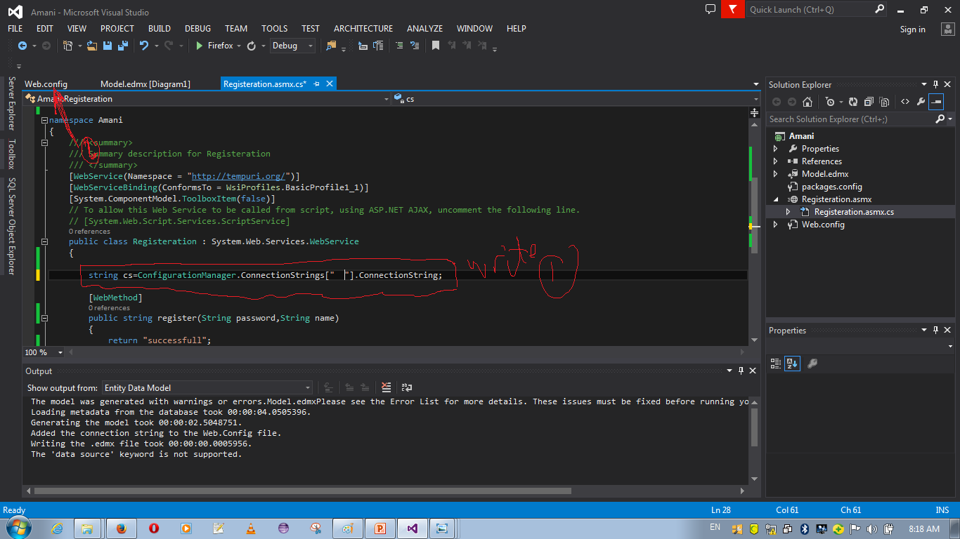

Slide 64
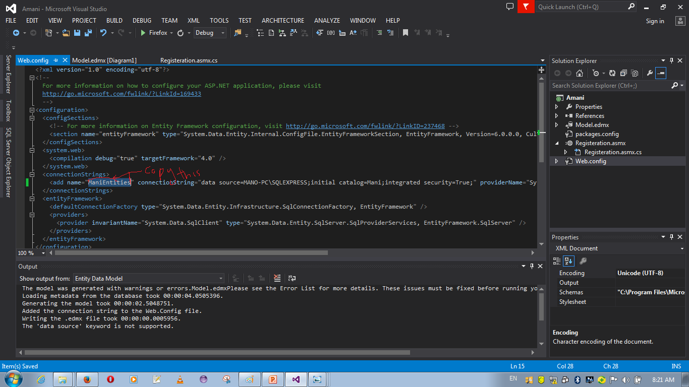

Slide 65
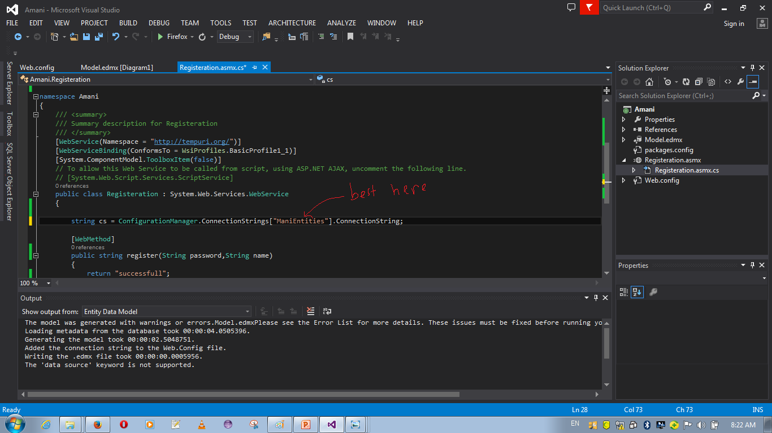

Slide 66
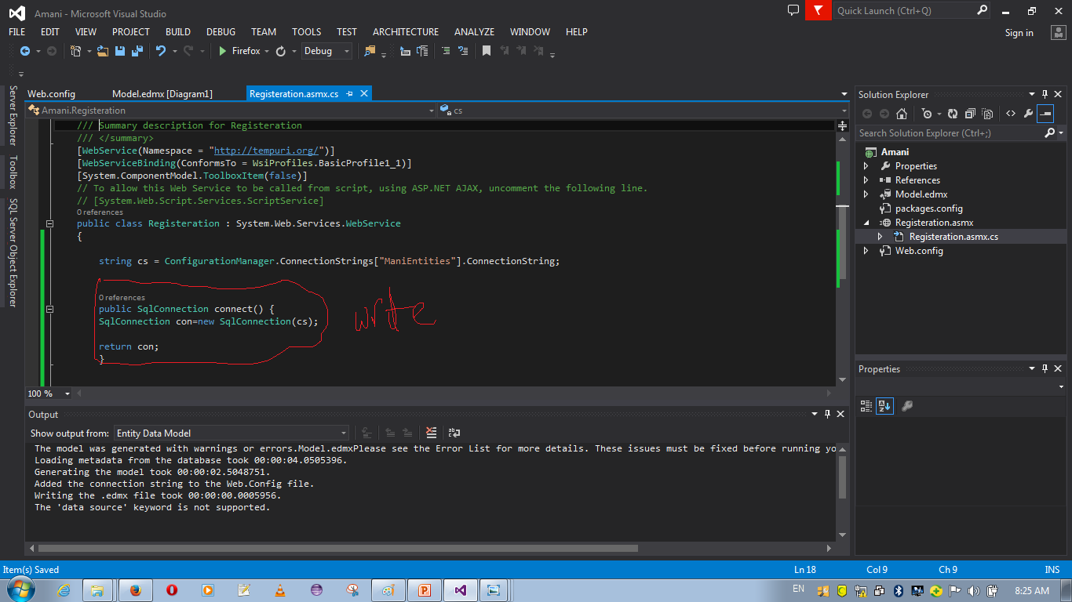

Slide 67
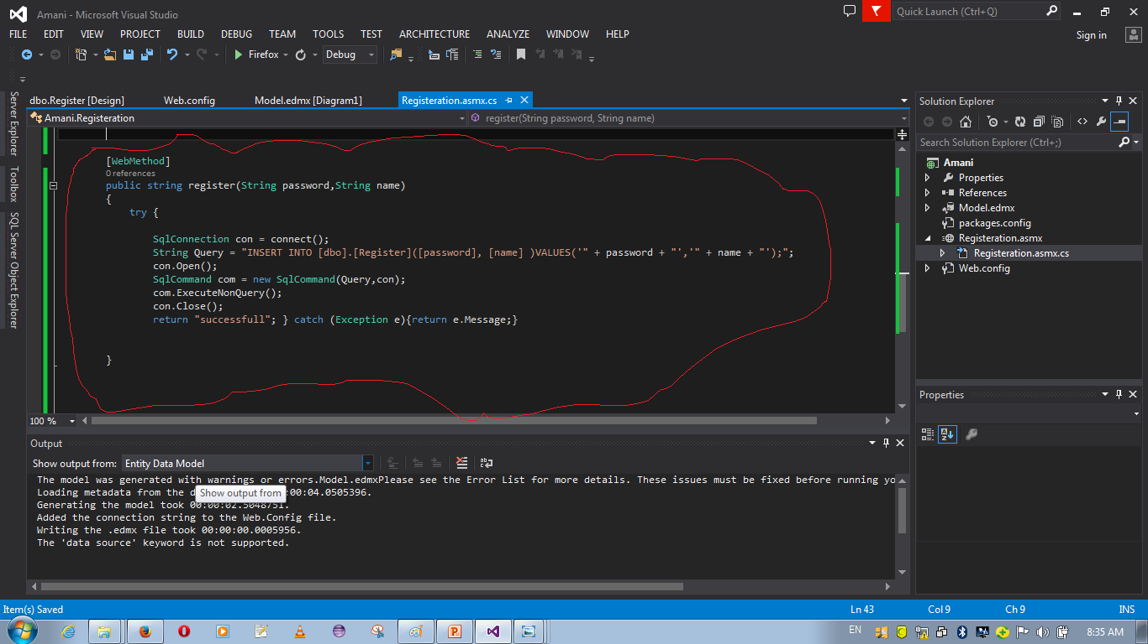

Slide 68
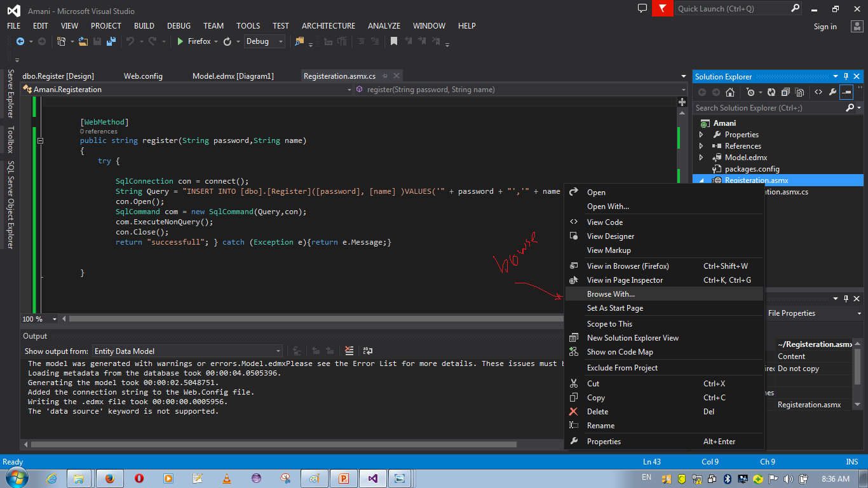

Slide 69
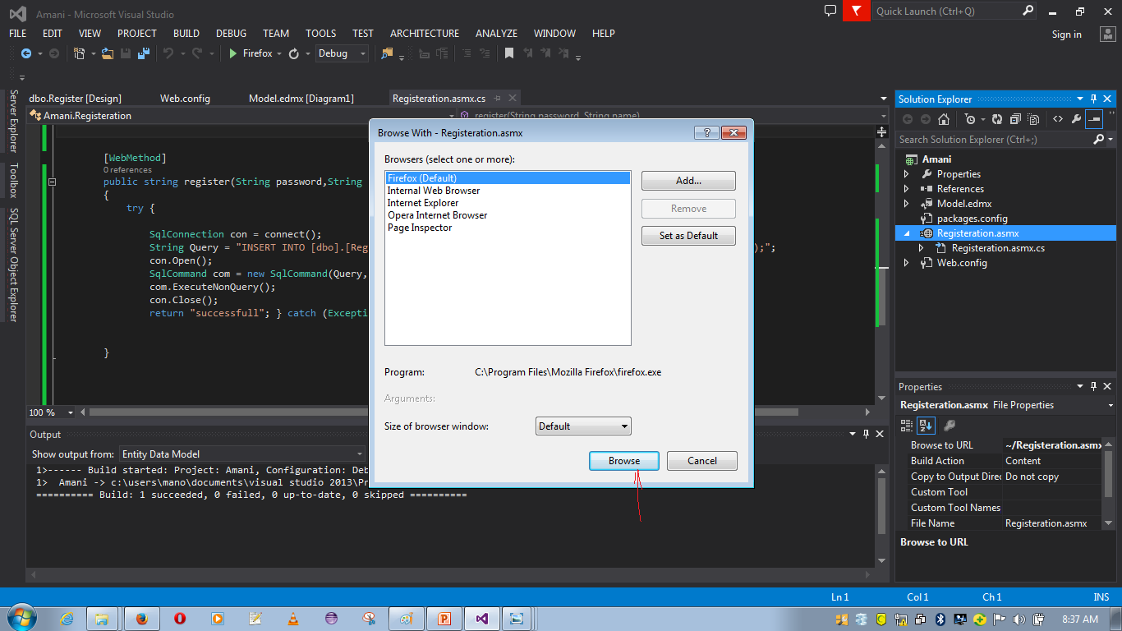

Slide 70
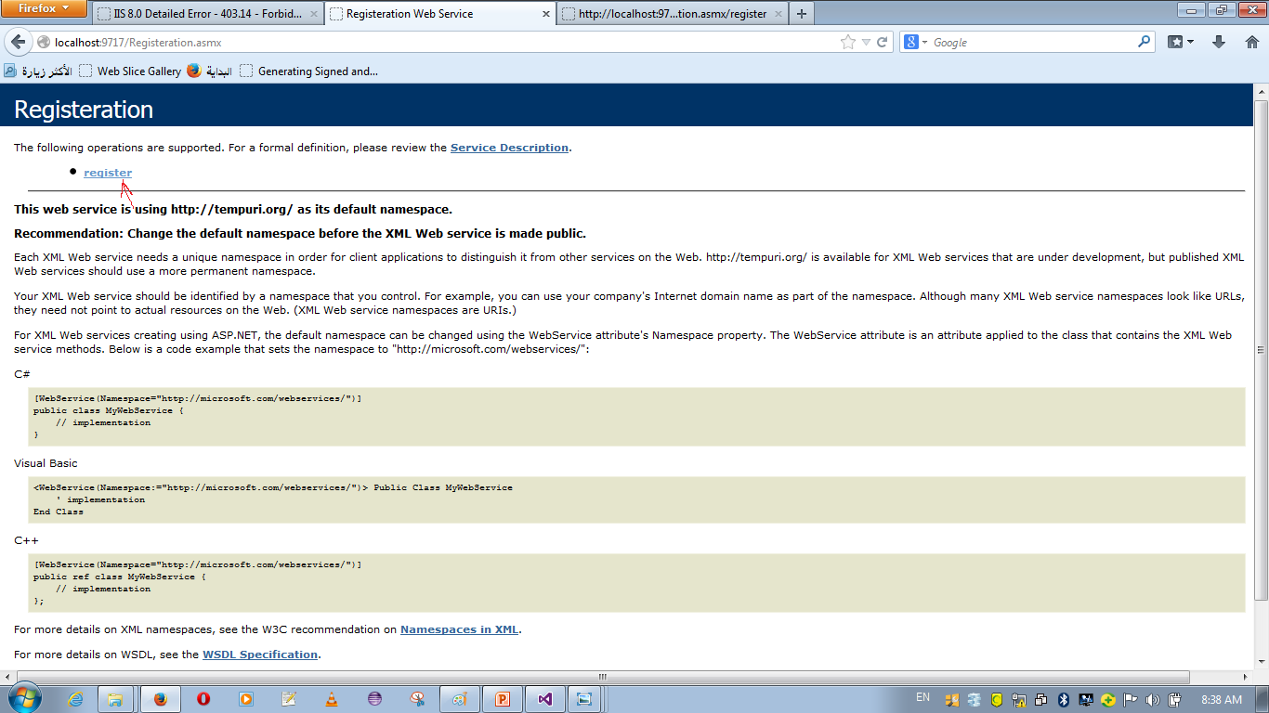

Slide 71
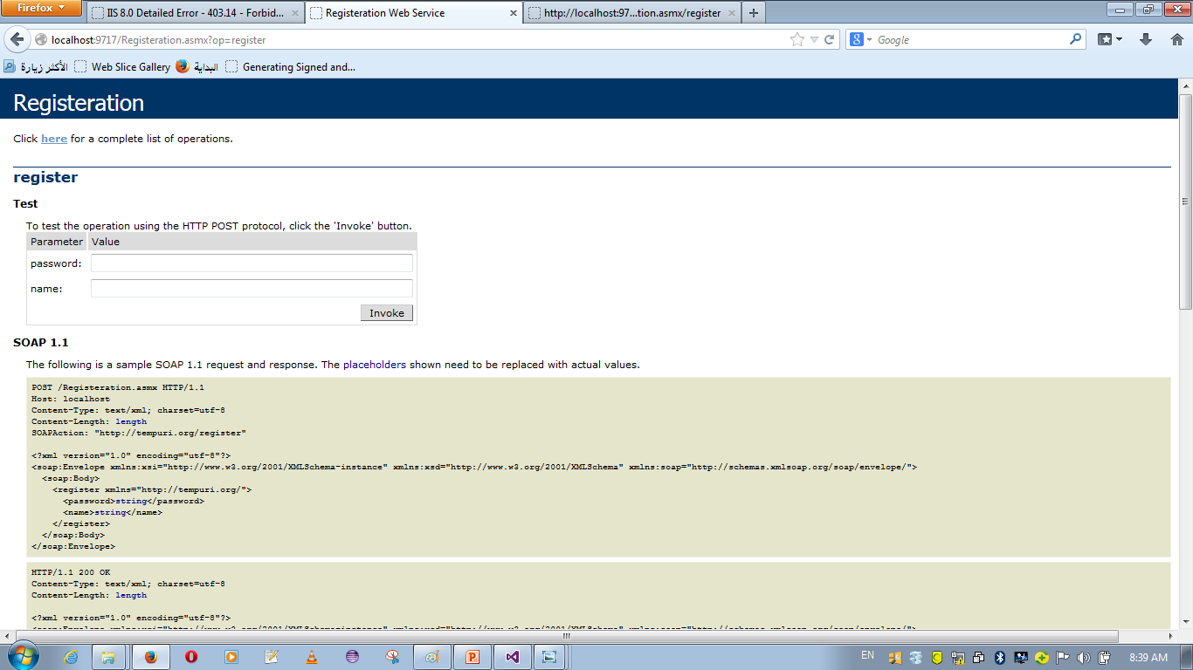

Slide 72
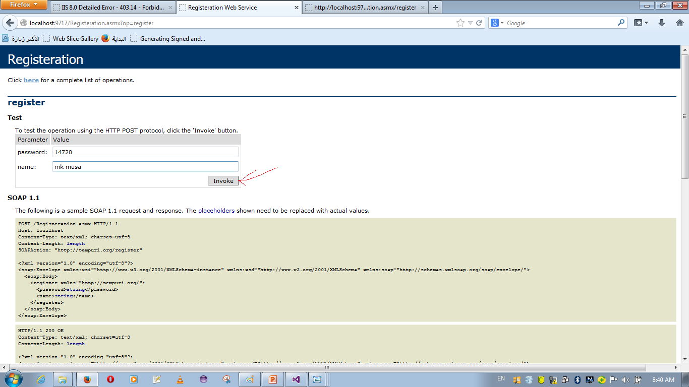

Slide 73
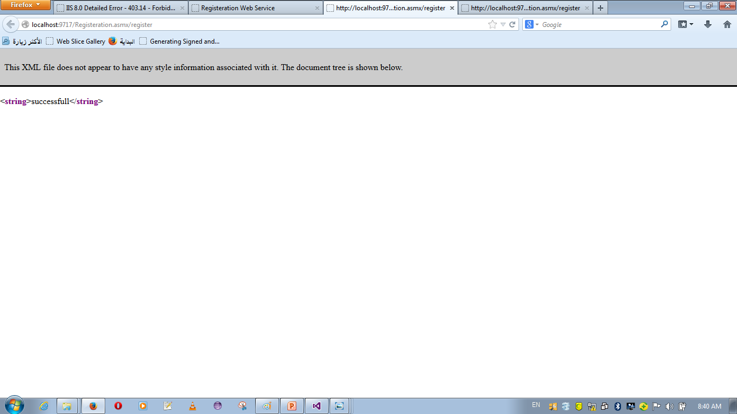

Slide 74
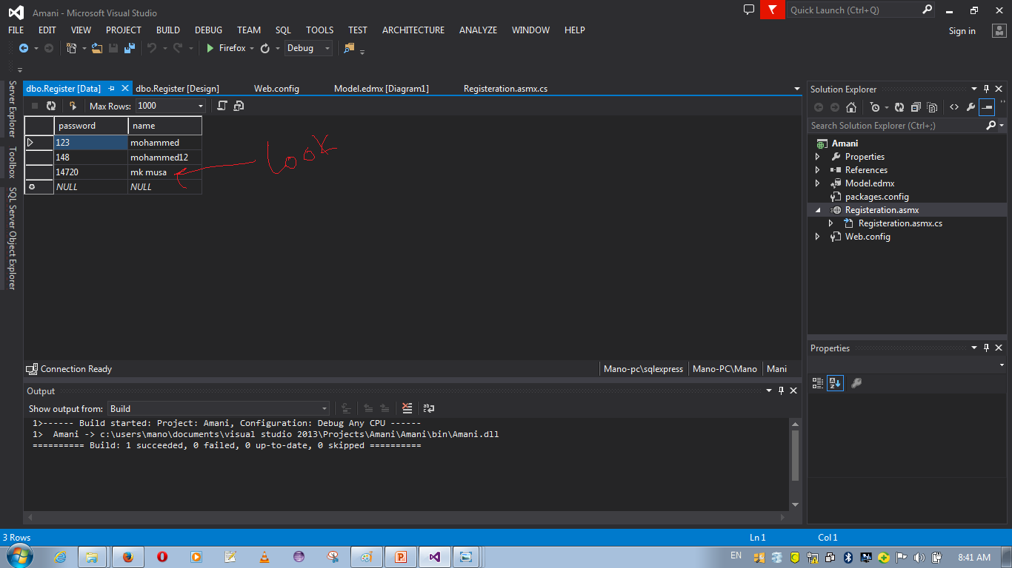

Slide 75
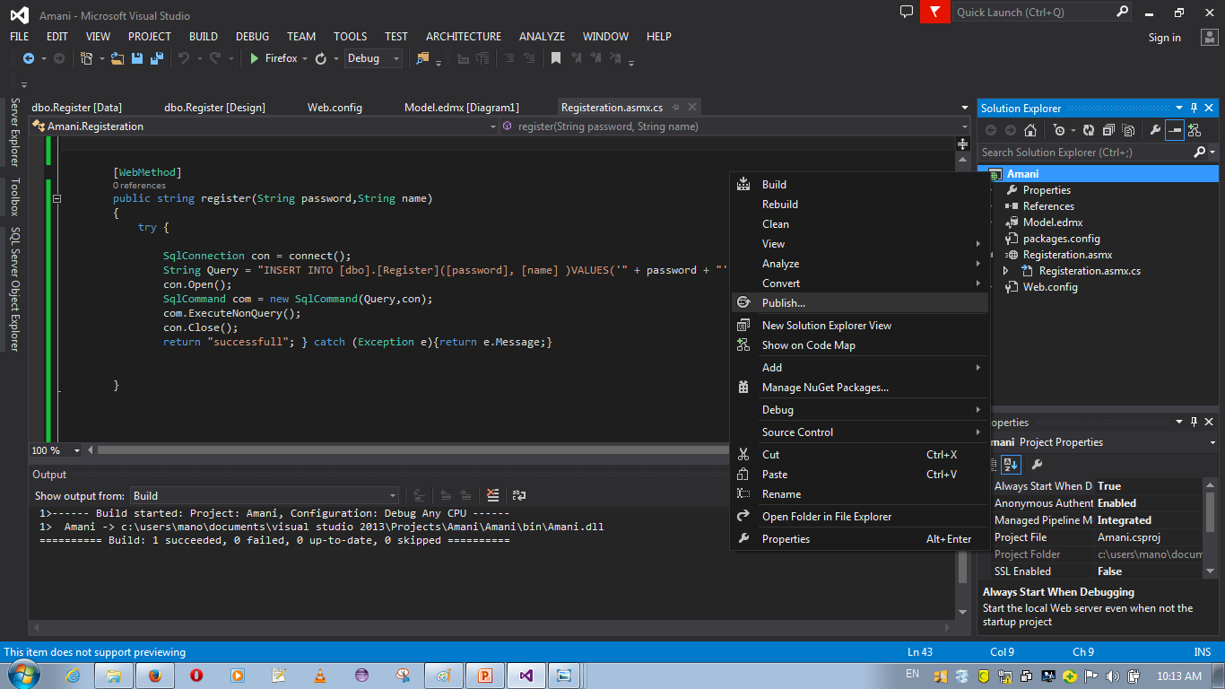
Create publish project

Slide 76


Slide 77


Slide 78


Slide 79


Slide 80


Slide 81


Slide 82


Slide 83


Slide 84
the third step
Install information services manager (IIS manager)
Configuration project on IIS Manager
Run project

Slide 85

Install IIS manager

Slide 86


Slide 87


Slide 88


Slide 89


Slide 90


Slide 91


Slide 92


Slide 93


Slide 94


Slide 95


Slide 96


Slide 97


Slide 98


Slide 99


Slide 100


Slide 101


Slide 102


Slide 103


Slide 104


Slide 105


Slide 106


Slide 107


Slide 108


Slide 109


Slide 110


Slide 111


Slide 112


Slide 113


Slide 114
Abbreviation term
Abbreviation term related web service | Meaning
SOAP | Simple Object Access Protocol
REST | representational state transfer
WSDL | Web Services Description Language
XINS | XML Interface for Network Services
WSCL | Web Services Conversation Language
WSFL | Web Services Flow Language
RPC | Remote Procedure Call
SWSDL | Subset WSDL
AWS | Autonomous Web Services

Slide 115
Reference
https://en.wikipedia.org/wiki/Web_service

